Slide 1
Update regarding the sensitivity
Result:
To improve the sensitivity of the GOP(graphite on paper)sensor, the GOP strip was assembled with the supporting base using double-sided tape. The aim of the supporting frame is to avoid resistance change due to the piezoresistive effect.
It is observed that GOP sensor is similar to thermistor with negative temperature coefficient.
Normal Respiration Rate for adults(above 18 years) is (12-16)breaths/minute.
My observation result an respiration rate of (14-17)breaths/minute , which is accurate according to the medical standards.
The graphite quality, dimensions of GOP, level of rubbing greatly determine the sensitivity of sensor.
The 2B graphite is more immune to disturbances than HB.
GOP sensor of area 2cm*0.5cm to 1.5cm*0.5cm are suitable for sensing. Smaller dimension sensors are unable is receive the warmth of the air.
Lightly rubbed sensors are less immune to disturbances. Heavily rubbed sensors are less sensitive. Moderately rubbed sensors are suitable for sensing.
According to my observations, usage of masks improves the sensitivity.

Slide 2
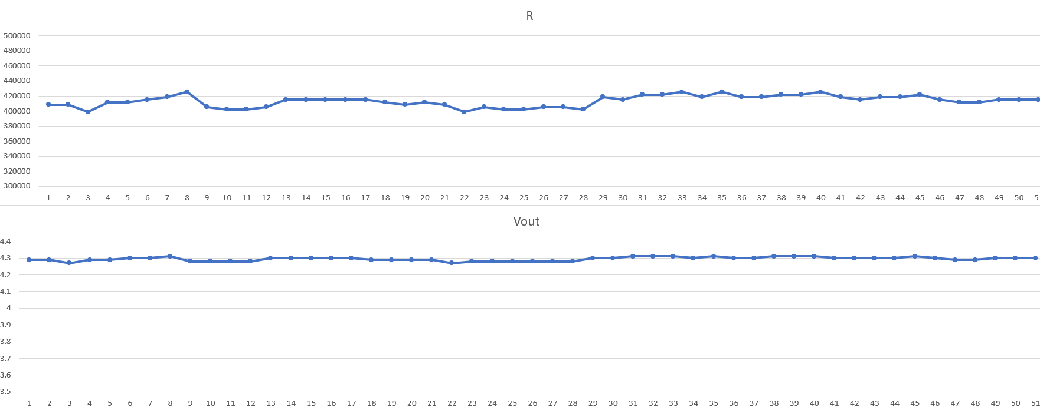
Lightly rubbing GOP sensor is less immune to disturbances.
The graphs shows the resistance and voltage across GOP sensor during normal conditions.
There is rapid change in resistance without any external input.

Slide 3
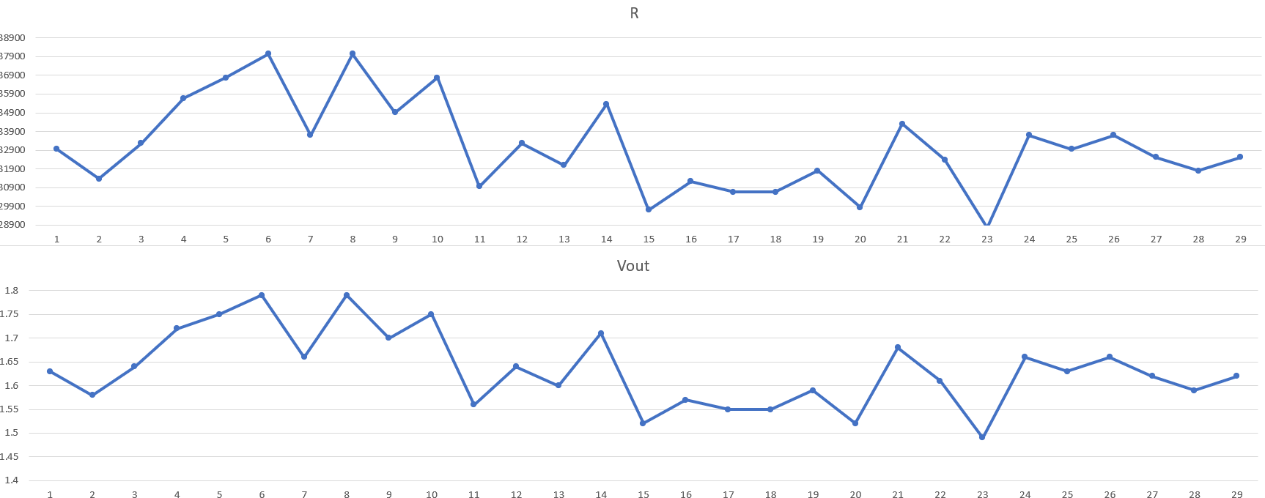
Lightly rubbed GOP sensor
The sensor resistance and voltage across GOP sensor during respiration.
The resistance change are uneven and not accurate.
The peaks are occurred due to inhalation and troughs are due to exhalation.

Slide 4
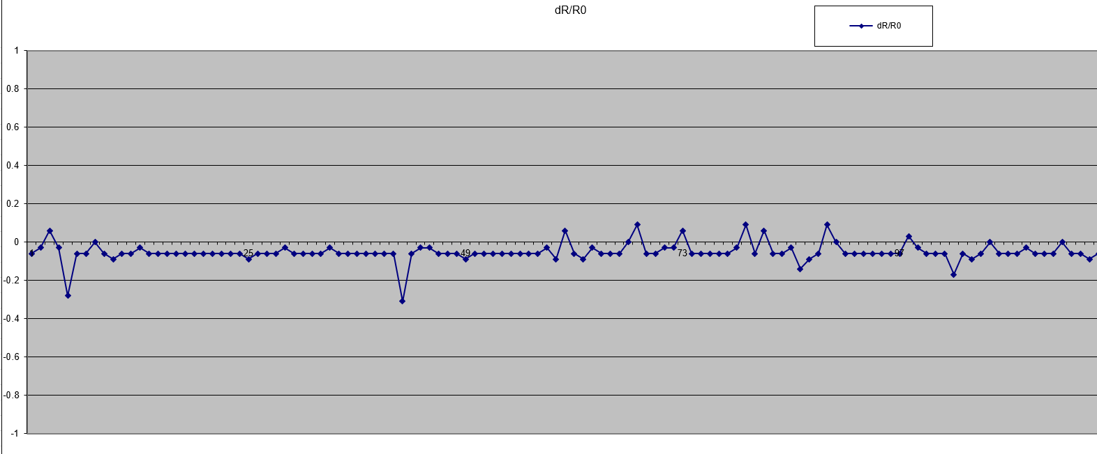
To get a clear understanding of the resistance change , we can use relative resistance.
The initial resistance value of the GOP sensor is R0.
The resistance values obtained during respiration are R.
So, relative resistance RR=(R-R0)/R0;
RR =dR/R0;
The graph shows the dR/R0 of Lightly rubbed GOP sensor during normal condition.

Slide 5
Arduino code to observe the dR/R0 value:
const int sensorPin = A0; // Analog input pin that senses Vout
int sensorValue = 0; // sensorPin default value
float Vin = 5; // Input voltage
float Vout = 0; // Vout default value
float Rref = 68000; // Reference resistor's value in ohms (you can give this value in kiloohms or megaohms - the resistance of the tested resistor will be given in the same units)
float R = 0;
int row_excel = 0; // number of lines
float RR=1;
const int R0=30672.91;
void setup ()
{
Serial.begin(9600); // Initialize serial communications at 9600 bps
Serial.println("CLEARDATA"); // clear excel sheet
Serial.println("LABEL,Time,Rows, R,Vout, dR/R0"); // column headers
}
void loop ()
{
sensorValue = analogRead(sensorPin); // Read Vout on analog input pin A0 (Arduino can sense from 0-1023, 1023 is 5V)
Vout = (Vin * sensorValue) / 1023; // Convert Vout to volts
R = Rref * (1 / ((Vin / Vout) - 1)); // Formula to calculate tested resistor's value
RR=(R-R0)/R0;
row_excel++; // row number + 1
Serial.print("DATA,TIME,"); // excel record current date and time
Serial.print(row_excel);
Serial.print(",");
Serial.print(R);
Serial.print(",");
Serial.print(Vout);
Serial.print(",");
Serial.println(RR);
// if rows are more than 50, then start filling the rows again
if (row_excel > 120){
row_excel = 0;
Serial.println("ROW,SET,2");
}
delay(1000); //delay
}

Slide 6
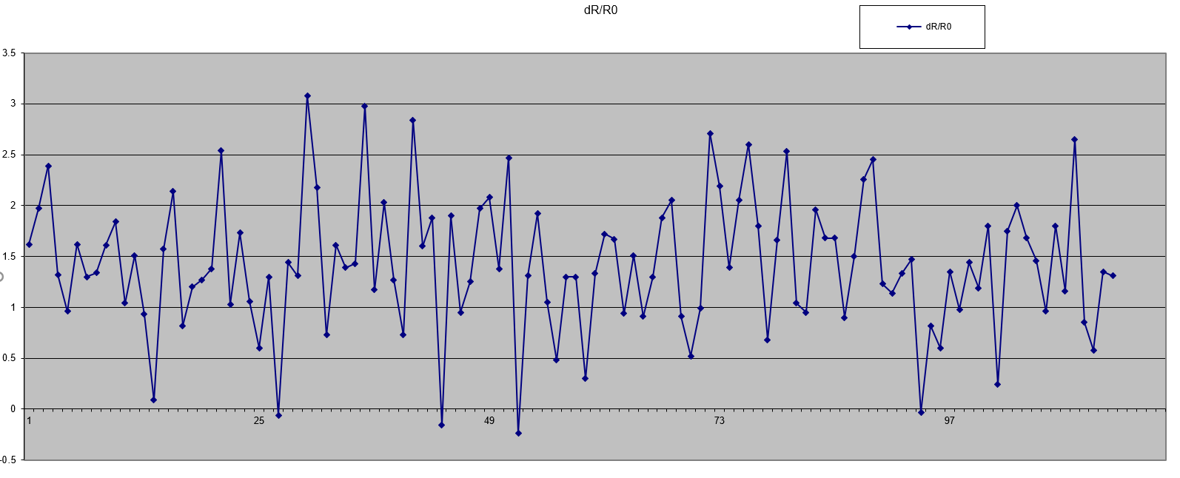
The below graphs shows the relative resistance of Lightly rubbed GOP sensor (HB pencil) during the respiration.
The peaks are occurred during inhalation and troughs occurred during the exhalation.

Slide 7
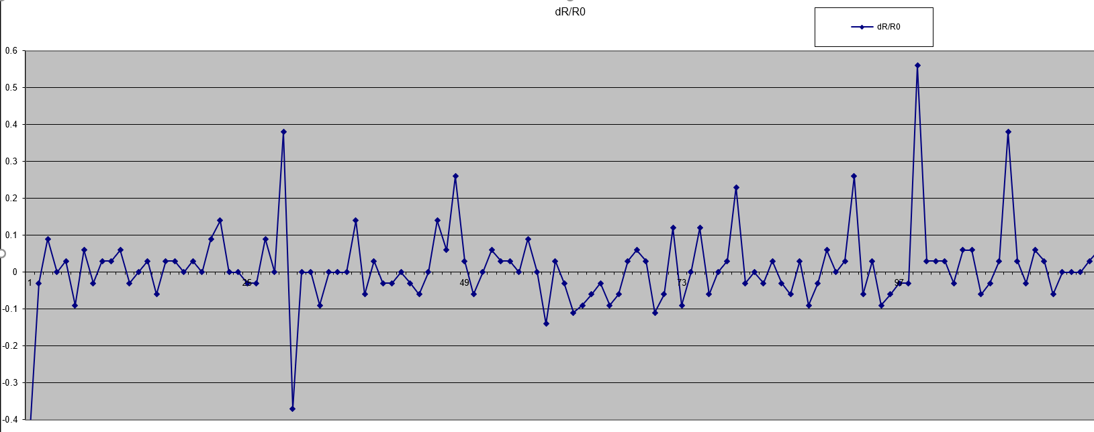

Slide 8
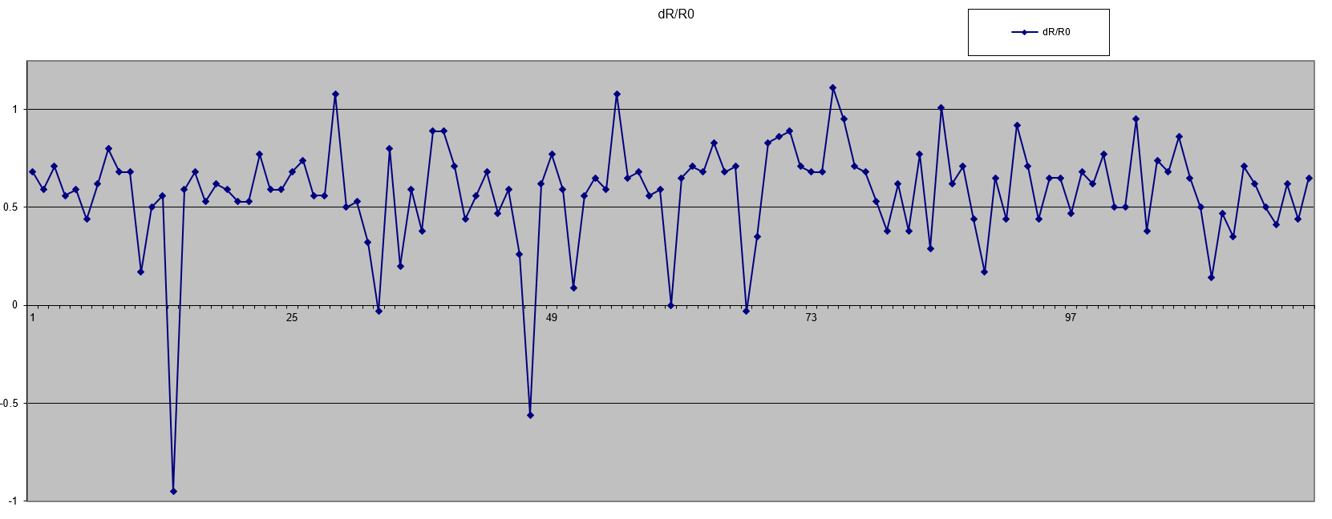

Slide 9
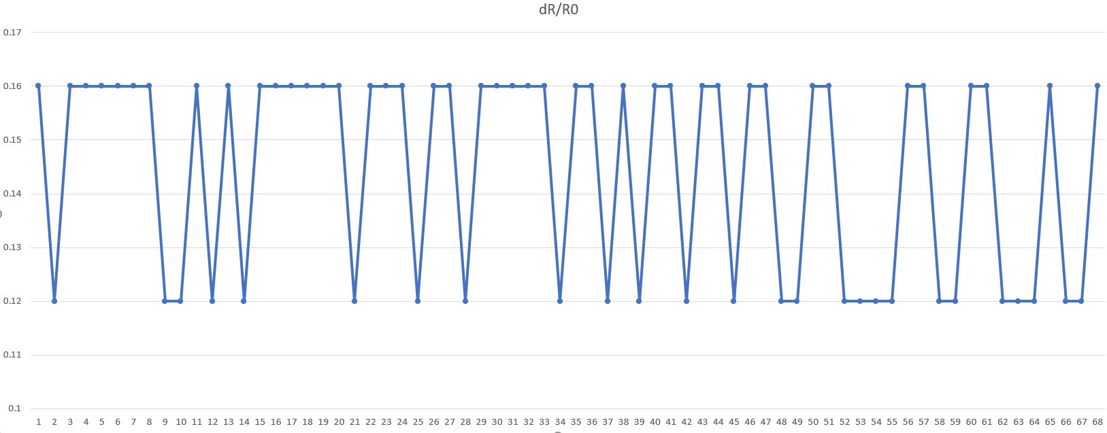
Moderately rubbed GOP sensor with 2B graphite.
The values obtained at 0.16 are due to the inhalation.
The values obtained at 0.12 are due to the exhalation.
The area of the GOP sensor is 1cm*0.5cm.
We can find the respiration rate by counting the peaks i.e. , 15(breaths/minute).

Slide 10
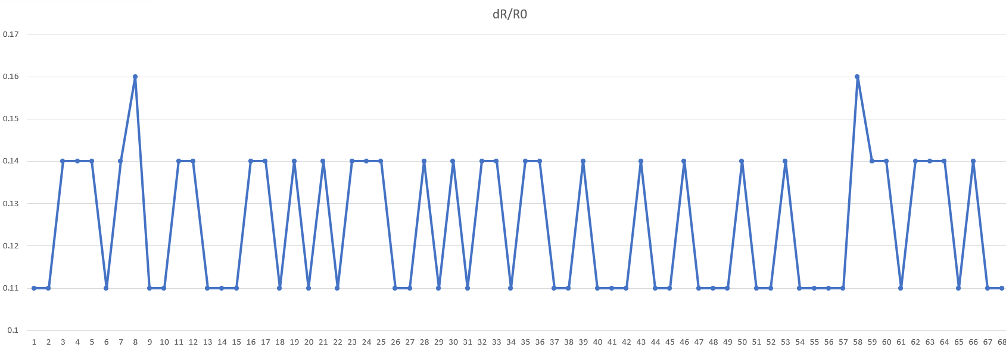
Moderately rubbed GOP sensor with 2B graphite.
The values obtained at 0.16 are due to the inhalation.
The values obtained at 0.12 are due to the exhalation.
The area of the GOP sensor is 2cm*0.5cm
We can find the respiration rate as the no.of peaks i.e., 17 breaths per minute.

Slide 11
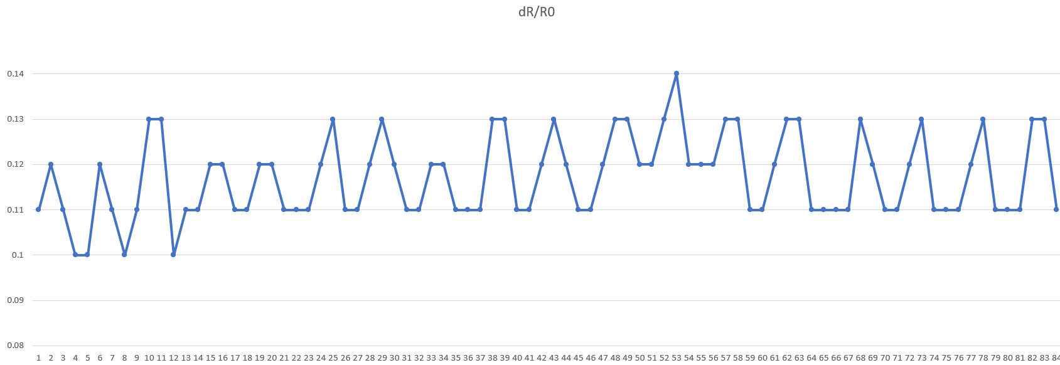
Respiration Rate without wearing mask gives the respiration rate as shown in the graph i.e., 14 breaths/minute.

Slide 12
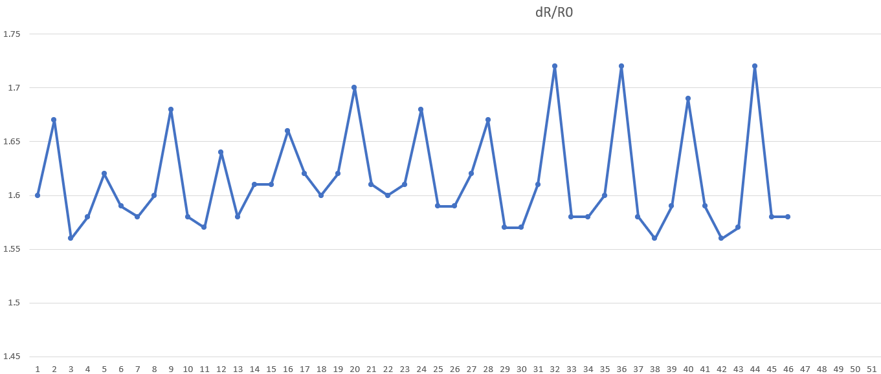
Taking the reading with the usage of the mask, resulted in proper and accurate measurement of respiration rate.
The peaks are due to the inhalation and troughs are due to the exhalation . It occurred due to the negative temperature coefficient of graphite.

Slide 13
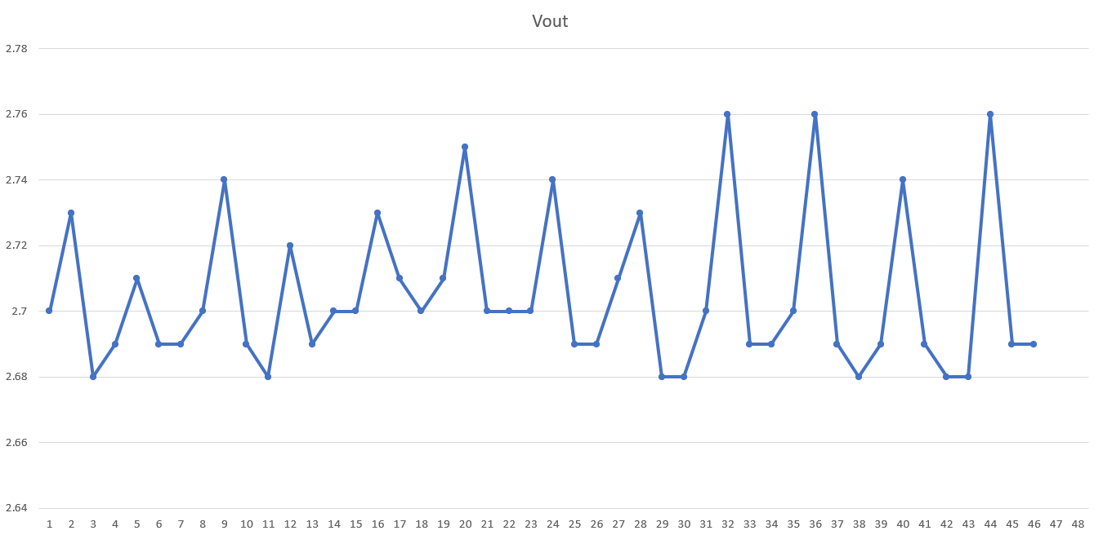
The Voltage across the GOP sensor during the respiration.
The next task is to conditioning the signal obtained from the GOP sensor.

